Slide 1
LECTURE #06 NATIONAL RURAL SUPPORT PROGRAMME (NRSP)

Slide 2
NRSP’S OUTREACH
Gilgit
GILGIT
BALTISTAN
NRSP Programme Districts
Swat
NRSP Hub Offices
Skardu
Malakand
Buner
Muzaffarabad
NRSP District Offices
KHYBER
PAKHTUNKHWA
Charsadda
Mardan
Swabi
Peshawar
Nowshera
Bagh
Poonch
Haveli
JAMMU
& KASHMIR
Attock
Islamabad
Sudhnuti
NRSP Field Units
Rawalpindi
Kotli
Mirpur
Bhimber
Disputed Territory
UPAP Districts
Mianwali
Chakwal
Jhelum
Gujrat
Mandi
Bahuddin
Sialkot
Khushab
Sargodha
Hafizabad
Gujranwala
Narowal
Bahkkar
Chiniot
Sheikhupura
Jhang
Faisalabad
Nankana
Lahore
Layyah
Toba Tek Singh
Kasur
PUNJAB
Sahiwal
Okara
Quetta
DG Khan
Muzaffargarh
Khanewal
Pakpattan
Multan
Vehari
Lodhran
Bahawalnagar
Rajanpur
BALOCHISTAN
Bahawalpur
Rahim Yar Khan
Ghotki
Sukkur
Panjgur
SINDH
4
Provinces & AJK
Shaheed
Benazirabad
67
Programme Districts
Kech (Turbat)
Awaran
Lasbela
Jamshoro
Matiari
Tando
Allah Yar
190
Field Units
Gwadar
Hyderabad
Mirpur Khas
Umerkot
Karachi
Tando M. Khan
730
Settlement Offices
Thatta
Badin
Sujawal

Slide 3
ORGANIZATION STRUCTURE OF NRSP

Slide 4
NRSP VISION, MISSION AND STRATEGY
Vision
All rural households in the country are organized into vibrant and inclusive institutions for poverty reduction and sustainable development
Core Assumption
People have tremendous potential and willingness
Organizational Objective
To foster a countrywide network of grassroots level organizations to enable rural communities to plan, implement and manage developmental activities and programmes for the purpose of ensuring productive employment, alleviation of poverty and improvement in the quality of life.
Organizational Strategy
To harness peoples potential to help themselves

Slide 5
COMMUNITY ORGANIZATION (CO)
Group of people (about 10-25 households)
One from each household
Live in same geographical proximity and share common interests
Select their own office bearers (President and Manager)
Meet Regularly
Member households save and pool their individual savings into a joint CO account
Decision by absolute majority, in general body and in writing

Slide 6
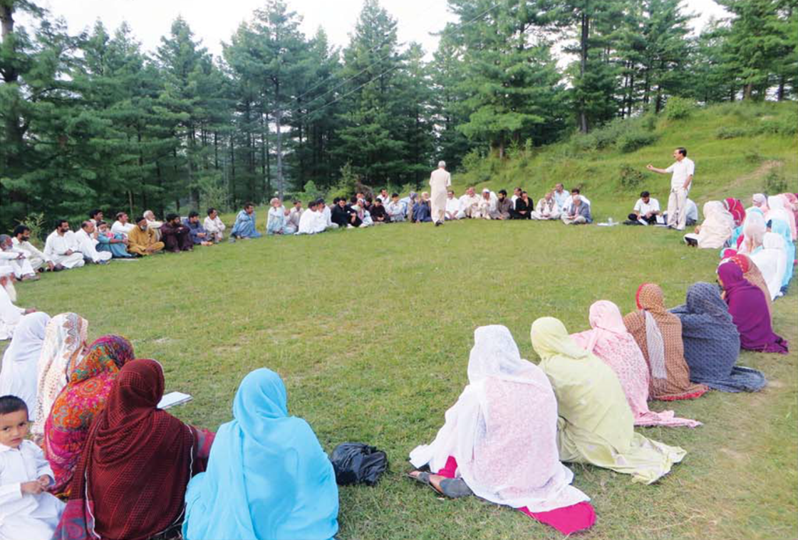
FORMATION OF COMMUNITY ORGANIZATIONS

Slide 7
STEPS AND PROCESSES TO UNDERTAKE DEVELOPMENT
Situational Analysis and Poverty Assessment
Offering partnership to community specially the poor through a series of Programme dialogues
Organize willing communities at settlement/mohalla level as Community Organizations (COs) for pooling of resources, cutting down overheads, achieving economies of scale etc
The COs federate at Village level into Village Organizations (VOs) and VOs federate at Union Council levels as Local Support Organizations(LSOs)
Identify true and genuine activists and Community Resource Persons (CRPs) from amongst the community.
It is only they who can harness the potential of the people not outsiders

Slide 8
Cont..
Identify and prioritize what people are willing to undertake in terms of opportunities and needs but not demands
Micro Investment Plans
Village Development Plans
Undertake feasibility of identified opportunities and needs in terms of peoples capacity, willingness, equity, sustainability, availability and requirement of resources
Facilitate the flow of required resources to the community
Monitor, lobby and establish linkages between communities and other development agencies, such as government departments and donors

Slide 9
SITUATIONAL ANALYSIS AND POVERTY ASSESSMENT
Village/Union Council level Socio Economic Survey
Local economic factors, professions, landholding, natural resources etc
Levels of education, health, Public infrastructure, imports and exports of the village
Communities perception on the problems of utmost importance confronting them and past efforts to overcome them
Carpet survey/census of all households in a union council using the Poverty Score Card approved for the BISP.

Slide 10
Cont..
The results are analysed into different poverty bands to identify intervention for each band
Categories | Score Range
Extremely Poor | 0-11
Chronically Poor | 12-18
Transitory Poor | 19-23
Transitory Vulnerable | 24-34
Transitory Non-Poor | 35-59
Non-Poor | 60-100

Slide 11
PREPARATION OF MICRO INVESTMENT PLANS (MIPS) AND VILLAGE DEVELOPMENT PLANS (VDPS)
Levels | Plans and Needs Identified | Interventions
Household Level Plans (MIPs) | Income Generation | Income generating grants, asset transfer for the destitute Access to loans capital (CIF, micro credit, savings) Skills enhancement trainings leading to employment generation
Village Level Plans (VDPs)/UC Plans | Community infrastructure schemes for clean drinking water, irrigation, sanitation etc Health and family planning services Education WASH services Productivity enhancement of agriculture and livestock | Access to technical (engineering) and financial services to accomplish the identified plans Support for project design, resource mobilization and development of linkages with local government and other development organizations

Slide 12
NRSP’S DEVELOPMENT SECTORS
Social Mobilization (SM)
Human Resource Development (HRD)
Microfinance & Enterprise Development Programme (MEDP)
Gender And Development
Physical Infrastructure and Technology Development (PITD)
Environment and Natural Resource Management (E&NRM)
Social Sector Services
Social & Human Protection

Slide 13
Social Mobilization: Federating the COs
Local Support Organization (LSO)
>Federation of Village Organizations at UC level
> LSO Leaders, Executive Committee and
General Body
> Exec Comtt.: all VO leaders; General Body: All CO leaders
> All villages represented in LSO
LSO
Village Organization (VO)
> Federation of Community Organizations
> Leaders and General Body (all CO Presidents and Managers)
> All mohallas/settlements represented in VO
> 100% inclusion of poorest households through COS
VO
Community Organizations (COs)
> Participatory body (Leaders and Members)
> Separate COs for Men and Women (if required) and each CO to have 15-25 members
CO
CO
CO

Slide 14
Fostering A Three-Tiered Social Mobilization Network
President
797
(LSOs)
LSO
Manager
3.27 million
households organized
President
7,231
(VOs)
VO
VO
Manager
Manager
HH Member
President
CO
CO
CO
204,485
(COs)

Slide 15
GRANT SUPPORT TO THE POOREST/DESTITUTE
67,634 poorest rural household have benefited from micro grants for productive assets/IGG
Small and large livestock, assets and tool kits for the establishment of enterprises/ businesses, income generating grants, grants for rehabilitation/recovery after emergencies etc
50% women beneficiaries
Major donors/funding agencies
PPAF, Government of Pakistan, IFAD, UNDP, EU, World Bank, ADB, Government of Italy etc

Slide 16
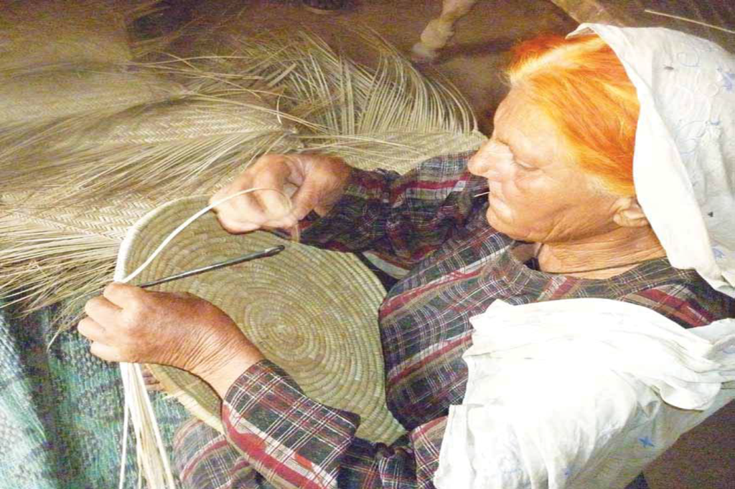
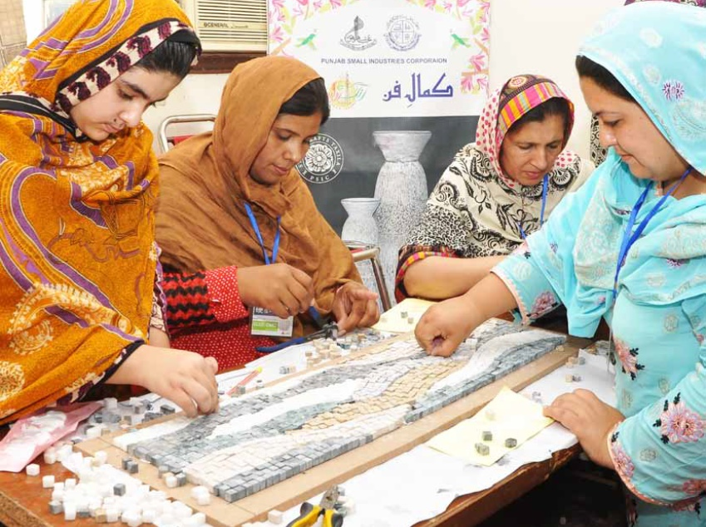
MICROFINANCE AND ENTERPRISE DEVELOPMENT PROGRAMME (MEDP)

Slide 17
MICROFINANCE PRODUCTS
MEDP Products | Description
Community Investment Fund (CIF): Community Managed Financial Services | CIF grant provided to women COs, VOs and LSOs who use it as revolving credit fund to extend loans to the poor who are not served by NRSP
Interest Free Loans | Government’s schemes to provide interest free loans to clients identified through Poverty Scorecard (0-23)
Core microcredit | Small loans as working capital provided to urban and rural clients for agriculture, livestock and small businesses
Micro Health and accidental death Insurance | Micro credit client are provided insurance cover to meet expenses on hospitalization, disability and accidental death

Slide 18
MICRO CREDIT DISBURSEMENT IN DIFFERENT SECTORS

Slide 19
HUMAN RESOURCE DEVELOPMENT PROGRAMME
Mandatory training for community leaders and managers in leadership and managerial skills
Mandatory NRSP Orientation Training Workshop (OTW) for all staff
Demand/market based vocational and technical skills training programme

Slide 20
PHYSICAL INFRASTRUCTURE AND TECHNOLOGY DEVELOPMENT PROGRAMME
The COs/VOs identify the scheme
The COs/VOs participate in the implementation of the scheme
The COs/VOs take responsibility for Operation and Maintenance

Slide 21
ENVIRONMENT AND NATURAL RESOURCE MANAGEMENT (ENRM)
Forges linkages with government line agencies and private service providers
Imparts training to farmers
Fosters Community Resource Persons/Workers
Provides knowledge and information about methods of managing agriculture and livestock
Implements special projects e.g Sugarcane Productivity Enhancement Project
Prime Minister’s Initiative for Livestock
Ongoing Vaccination Programme
Agriculture Innovation Programme

Slide 22
SOCIAL SECTOR SERVICES
Education
Increasing access to education by supplementing the government efforts and participating in donor programmes
Collaboration with Provincial Education Sector Strengthening Programme, Provincial Education Foundations
Capacity building of Schools Management Committees, Teachers Training, Schools Improvement Plans, Missing facilities
Early childhood education
Adult Literacy and education for girls
Establishment and support for community Schools

Slide 23
Cont..
Health
Increasing access to health services by supplementing the government efforts;
Immunization and Polio Initiatives
Participation in projects for Mother and child health care, Reproductive health and family planning, Nutrition
Malaria prevention and control
Support to people with functional disabilities
Medical camps, Eye care initiatives etc

Slide 24
NRSP AS RELIEF, REHABILITATION AND RECONSTRUCTION ORGANIZATION
Preparing communities for disaster risks assessment and management
Participation in rescue efforts with government agencies
Participation in relief efforts in collaboration with local communities, donors and governments
Special projects for recovery and rehabilitation
Reconstruction of houses and local infrastructure (over 40,000 houses)

Slide 25
EXISTING OVERSIGHT MECHANISM
NRSP has a 14 members BoD
3 Federal Secretaries as ex-officio Directors
Board meetings are held on a quarterly basis
External statutory Annual Audit
Ernest & Young
Internal Audit
Internal Audit Department set up under the direct supervision of the Chairman Internal Audit Committee of the Board;
Secretary Finance member of the Audit Committee
Separate audit by donors for every project
Institutional assessments by donors
Pre-award institutional assessments carried out by USAID and EU
Micro assessments done by UNDP, UNICEF, OXFAM and many other institutions

Slide 26
SYSTEMS IN PLACE AND FINANCIAL CAPACITY
Manuals for Financial Management, Internal Audit, HR, Procurement, Social Mobilization, IT, Physical Infrastructure and Technology Development, Microfinance and Enterprise Development , MER and HRD
Strong IT section to design and maintain MIS
Policy guidelines and major approvals by Finance Committee and oversight by the Internal Audit Committee of the Board of Directors
Ability to access commercial credit lines
Over 500 Bank Accounts
Strong HRM and HRD system in place
Strong Procurement system in place
Projects Tracking Systems
Weekly, monthly, six monthly Programme Planning Meetings at all levels

Slide 27
NRSP AS A SUPPORT ORGANIZATION
Played its role for establishing and strengthening the following organizations/RSPs
Ghazi Barotha Taraqiati Idara (GBTI)
Punjab Rural Support Programme (SRSP)
Rural Support Programmes Network (RSPN)
Khushhali Bank
Sindh Rural Support Organisation (SRSO)
Support RSPs and other development organizations for the following
Project design, operational management and M&E
Selects sponsors
Registration
Recruitment and training of staff
Corporate matters for initial period
Financial management systems

